Slide 1
VE281 Data Structures and Algorithms
Hashing: Collision Resolution
Learning Objectives:
Understand separate chaining
Understand the general idea of open addressing
Know three basic ways of open addressing and their advantages and disadvantages

Slide 2
Announcement
No OH tomorrow (9/29)

Slide 3
Outline
Collision Resolution: Separate Chaining
Collision Resolution: Open Addressing
Linear Probing
Quadratic Probing and Double Hashing
Performance of Open Addressing

Slide 4
Collision Resolution Scheme
Collision-resolution scheme: assigns distinct locations in the hash table to items involved in a collision.
Two major scheme:
Separate chaining
Open addressing

Slide 5
Separate Chaining
Each bucket keeps a linked list of all items whose home buckets are that bucket.
Example: Put pairs whose keys are 6, 23, 34, 28, 29, 7, 33, 30 into a hash table with $n=7$ buckets.
homeBucket = key % 7
Note: we insert object at the beginning of a linked list.
[0]
7
28
[1]
29
[2]
30
23
[3]
[4]
[5]
33
[6]
34
6

Slide 6
Separate Chaining
Value find(Key key)
Compute k = h(key)
Search in the linked list located at the k-th bucket (e.g., check every entry) with the key.
void insert(Key key, Value value)
Compute k = h(key)
Search in the linked list located at the k-th bucket. If found, update its value; otherwise, insert the pair at the beginning of the linked list in O(1) time.

Slide 7
Separate Chaining
Value remove(Key key)
Compute k = h(key)
Search in the linked list located at the k-th bucket. If found, remove that pair.

Slide 8
Short Break

Slide 9
Outline
Collision Resolution: Separate Chaining
Collision Resolution: Open Addressing
Linear Probing
Quadratic Probing and Double Hashing
Performance of Open Addressing

Slide 10
Open Addressing
Reuse empty space in the hash table to hold colliding items.
To do so, search the hash table in some systematic way for a bucket that is empty.
Idea: we use a sequence of hash functions h₀, h₁, h₂, . . . to probe the hash table until we find an empty slot.
I.e., we probe the hash table buckets mapped by h₀(key), h₁(key), …, in sequence, until we find an empty slot.
Generally, we could define h_{i}(x) = h(x) + f(i)

Slide 11
Open Addressing
Three methods:
Linear probing: h_{i}(x) = (h(x) + i) % n
Quadratic probing: h_{i}(x) = (h(x) + i²) % n
Double hashing: h_{i}(x) = (h(x) + i*g(x)) % n
n is the hash table size

Slide 12
Linear Probing
h_{i}(key) = (h(key)+i) % n
Apply hash function h₀, h₁, …, in sequence until we find an empty slot.
This is equivalent to doing a linear search from h(key) until we find an empty slot.
Example: Hash table size n = 9, h(key) = key%9
Thus h_{i}(key) = (key%9+i)%9
Suppose we insert 1, 5, 11, 2, 17, 21, 31 in sequence
1
11
5
How about 2?
[0] | [1] | [2] | [3] | [4] | [5] | [6] | [7] | [8]

Slide 13
Linear Probing Example
Hash table size n = 9, h(key) = key%9
Thus h_{i}(key) = (key%9+i)%9
Suppose we insert 1, 5, 11, 2, 17, 21, 31 in sequence.
h₀(2) = 2. Not empty!
So we try h₁(2) = 3. It is empty, so we insert there!
h₀(21) = 3. Not empty!
h₁(21) = 4. It is empty, so we insert there!
h₀(31) = 4. Not empty!
h₁(31) = 5. Not empty!
h₂(31) = 6. It is empty, so we insert there!
1
11
2
21
5
31
17
[0] | [1] | [2] | [3] | [4] | [5] | [6] | [7] | [8]
Notes:
In summary, for linear probing, it is equivalent to doing a linear search from h(key) until we find an empty slot.

Slide 14
Linear Probing find()
With linear probing h_{i}(key) = (key%9+i)%9
How will you search an item with key = 31?
How will you search an item with key = 10?
Procedure: probe in the buckets given by h₀(key), h₁(key), …, in sequence until
we find the key,
or we find an empty slot, which means the key is not found.
1
11
2
21
5
31
17
[0] | [1] | [2] | [3] | [4] | [5] | [6] | [7] | [8]
Notes:
For linear probing, it is equivalent to doing a linear search from h(key) until we find an empty slot or find the key.

Slide 15
Linear Probing remove()
With linear probing h_{i}(key) = (key%9+i)%9
How will you remove an item with key = 11?
If we just find 11 and delete it, will this work?
1
11
2
21
5
31
17
[0] | [1] | [2] | [3] | [4] | [5] | [6] | [7] | [8]
1
2
21
5
31
17
[0] | [1] | [2] | [3] | [4] | [5] | [6] | [7] | [8]
What is the result for searching key = 2 with the above hash table?

Slide 16
Linear Probing remove()
cluster
After deleting 11, we need to rehash the following “cluster” to fill the vacated bucket.
However, we cannot move an item beyond its actual hash position. In this example, 5 cannot be moved ahead.
1
2
21
5
31
17
[0] | [1] | [2] | [3] | [4] | [5] | [6] | [7] | [8]
1
2
21
5
31
17
[0] | [1] | [2] | [3] | [4] | [5] | [6] | [7] | [8]
Notes:
Cluster: contiguous set of items
Note that although we do not move 5, but we still need to consider 31 which is also an element in the cluster.

Slide 17
Linear Probing Alternative implementation of remove()
Lazy deletion: we mark deleted entry as “deleted”.
“deleted” is not the same as “empty”.
Now each bucket has three states: “occupied”, “empty”, and “deleted”.
We can overwrite the “deleted” entry when inserting.
When we search, we will keep looking if we encounter a “deleted” entry.
1
del
2
21
17
11
5
31
[0] | [1] | [2] | [3] | [4] | [5] | [6] | [7] | [8]

Slide 18
Linear Probing Clustering Problem
cluster
Clustering: when contiguous buckets are all occupied.
Claim: Any hash value inside the cluster adds to the end of that cluster.
Problems with a large cluster:
It becomes more likely that the next hash value will collide with the cluster.
Collisions in the cluster get more expensive to resolve.
1
11
2
21
5
31
17
[0] | [1] | [2] | [3] | [4] | [5] | [6] | [7] | [8]

Slide 19
Linear Probing Clustering Problem
Assuming input size N, table size 2N:
What is the best-case cluster distribution?
What is the worst-case cluster distribution?
X |  | X |  | X |  | X
 |  | X | X | X | X

Slide 20

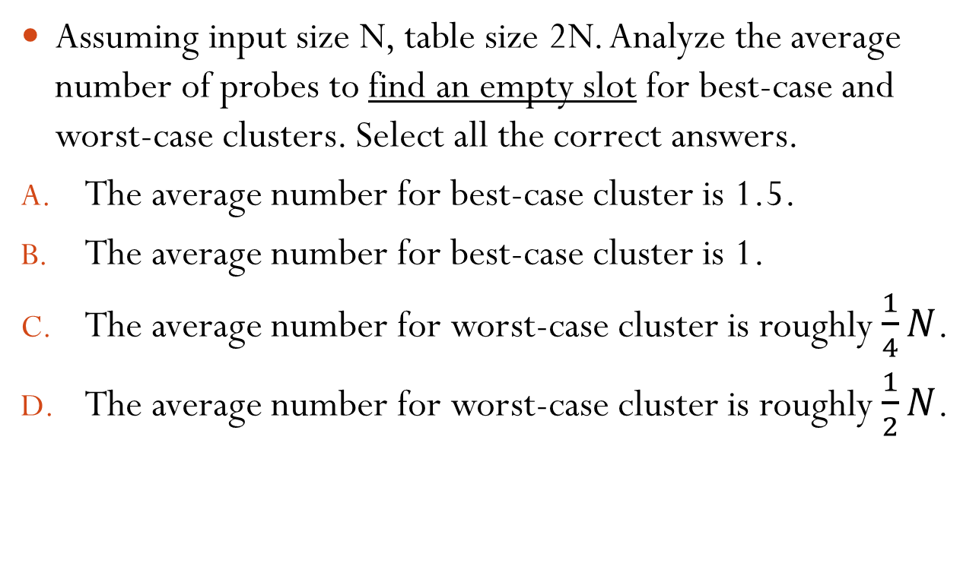
Which Statements Are Correct?
Assuming input size N, table size 2N. Analyze the average number of probes to find an empty slot for best-case and worst-case clusters. Select all the correct answers.
The average number for best-case cluster is 1.5.
The average number for best-case cluster is 1.
The average number for worst-case cluster is roughly $\frac{1}{4}N$.
The average number for worst-case cluster is roughly $\frac{1}{2}N$.
Best Case
X |  | X |  | X |  | X
Worst Case
 |  | X | X | X | X

Slide 21
Short Break

Slide 22
Outline
Collision Resolution: Separate Chaining
Collision Resolution: Open Addressing
Linear Probing
Quadratic Probing and Double Hashing
Performance of Open Addressing

Slide 23
Quadratic Probing
h_{i}(key) = (h(key)+i²) % n
It is less likely to form large clusters.
Example: Hash table size n = 7, h(key) = key%7
Thus h_{i}(key) = (key%7+i²)%7
Suppose we insert 9, 16, 11, 2 in sequence.
h₀(16) = 2. Not empty!
h₁(16) = 3. It is empty, so we insert there.
h₀(2) = 2. Not empty!
h₁(2) = 3. Not empty!
h₂(2) = 6. It is empty, so we insert there.
9
16
11
2
[0] | [1] | [2] | [3] | [4] | [5] | [6]
Notes:
Note: do not form a big cluster (not like linear probing)

Slide 24
Conflicts in Linear Probing
Inserting X
X conflicts with Y if h(X) = b(Y)
X conflicts with Z if X conflicts Y and Z conflicts with Y
X conflicts with W if X conflicts with Y and b(W) = b(Y)+1
0
7
14
3
10
17
[0] | [1] | [2] | [3] | [4] | [5] | [6]

Slide 25
Conflicts in Linear Probing
Inserting X
X conflicts with Y if h(X) = b(Y)
X conflicts with Z if X conflicts Y and Z conflicts with Y
X conflicts with W if X conflicts with Y and b(W) = b(Y)+1
21
0
7
14
3
10
[0] | [1] | [2] | [3] | [4] | [5] | [6]

Slide 26
Conflicts in Linear Probing
Inserting X
X conflicts with Y if h(X) = b(Y)
X conflicts with Z if X conflicts Y and Z conflicts with Y
X conflicts with W if X conflicts with Y and b(W) = b(Y)+1
21
0
7
14
3
10
[0] | [1] | [2] | [3] | [4] | [5] | [6]

Slide 27
Conflicts in Linear Probing
Inserting X
X conflicts with Y if h(X) = b(Y)
X conflicts with Z if X conflicts Y and Z conflicts with Y
X conflicts with W if X conflicts with Y and b(W) = b(Y)+1
21
0
7
14
3
10
[0] | [1] | [2] | [3] | [4] | [5] | [6]

Slide 28
Conflicts in Quadratic Probing
1
0
7
14
[0] | [1] | [2] | [3] | [4] | [5] | [6]

Slide 29
Conflicts in Quadratic Probing
1
0
7
4
11
[0] | [1] | [2] | [3] | [4] | [5] | [6]

Slide 30
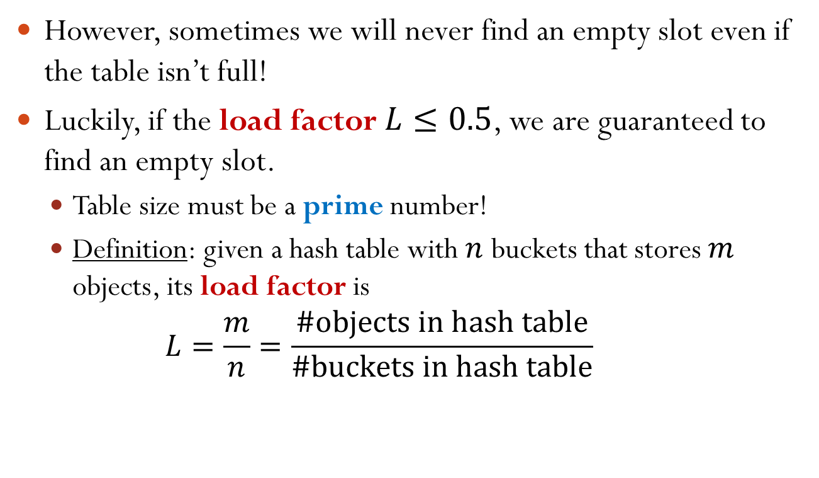
Problem of Quadratic Probing
However, sometimes we will never find an empty slot even if the table isn’t full!
Luckily, if the load factor $L≤0.5$, we are guaranteed to find an empty slot.
Table size must be a prime number!
Definition: given a hash table with $n$ buckets that stores $m$ objects, its load factor is $L=\frac{m}{n}=\frac{\#objects in hash table}{\#buckets in hash table}$

Slide 31
More on Load Factor of Hash Table
Question: which collision resolution strategy is feasible for load factor larger than 1?
Answer: separate chaining.
Note: for open addressing, we require $L≤1$.
Claim: $L=O(1)$ is a necessary condition for operations to run in constant time.
Notes:
For open addressing, the claim is obviously true, since L <= 1. For separate chaining, you can imagine that if L >> 1, it needs roughly ½ L comparison on average. Thus, the runtime is not constant.

Slide 32
Double Hashing
h_{i}(x) = (h(x) + i*g(x)) % n
Uses 2 distinct hash functions.
Increment differently depending on the key.
If h(x) = 13, g(x) = 17, the probe sequence is 13, 30, 47, 64, …
If h(x) = 19, g(x) = 7, the probe sequence is 19, 26, 33, 40, …
For linear and quadratic probing, the incremental probing patterns are the same for all the keys.
Notes:
The first example’s increment is 17 and the second example’s increment is 7

Slide 33
Double Hashing Example
Hash table size n = 7, h(key) = key%7, g(key) = (5-key)%5
Thus h_{i}(key) = (key%7+(5-key)%5*i)%7
Suppose we insert 9, 16, 11, 2 in sequence.
h₀(16) = 2. Not empty!
h₁(16) = 6. It is empty, so we insert there.
h₀(2) = 2. Not empty!
h₁(2) = 5. It is empty, so we insert there.
9
11
2
16
[0] | [1] | [2] | [3] | [4] | [5] | [6]
Notes:
Note: we only probe twice and find the bucket for 2; however, for quadratic probing, we probe three times.

Slide 34
Outline
Collision Resolution: Separate Chaining
Collision Resolution: Open Addressing
Linear Probing
Quadratic Probing and Double Hashing
Performance of Open Addressing

Slide 35
Performance of Open Addressing
Hard to analyze rigorously.
The runtime is dominated by the number of comparisons.
The number of comparisons depends on the load factor $L$.
Define the expected number of comparisons in an unsuccessful search as $U(L)$.
Define the expected number of comparisons in a successful search as $S(L)$.
Notes:
Insertion needs to verify duplicate and remove needs to verify existence. Both need to call find. For find, comparisons are needed to verify whether the key exists.

Slide 36
Expected Number of Comparisons
Linear probing
$$U\left(L\right)=\frac{1}{2}\left[1+{\left(\frac{1}{1−L}\right)}^{2}\right]$$
$$S\left(L\right)=\frac{1}{2}\left[1+\frac{1}{1−L}\right]$$
$$L$$ | $$U(L)$$ | $$S(L)$$
0.5 | 2.5 | 1.5
0.75 | 8.5 | 2.5
0.9 | 50.5 | 5.5
$L≤0.75$ is recommended.
Probabilistic analysis of linear probing
[Knuth (1962)]
Notes:
As expected, an unsuccessful search requires more comparisons than a successful search.

Slide 37

Expected Number of Comparisons
Quadratic probing and double hashing
$$U\left(L\right)=\frac{1}{1−L}$$
$$S\left(L\right)=\frac{1}{L}\ln{\frac{1}{1−L}}$$
$$L$$ | $$U(L)$$ | $$S(L)$$
0.5 | 2 | 1.4
0.75 | 4 | 1.8
0.9 | 10 | 2.6
Notes:
As we expect, performance of quadratic probing and double hashing is better than linear probing.

Slide 38
Which Strategy to Use?
Both separate chaining and open addressing are used in real applications.
Some basic guidelines:
If space is important, better to use open addressing.
If need removing items, better to use separate chaining.
remove() is tricky in open addressing.
In mission critical application, prototype both and compare.

